Slide 1
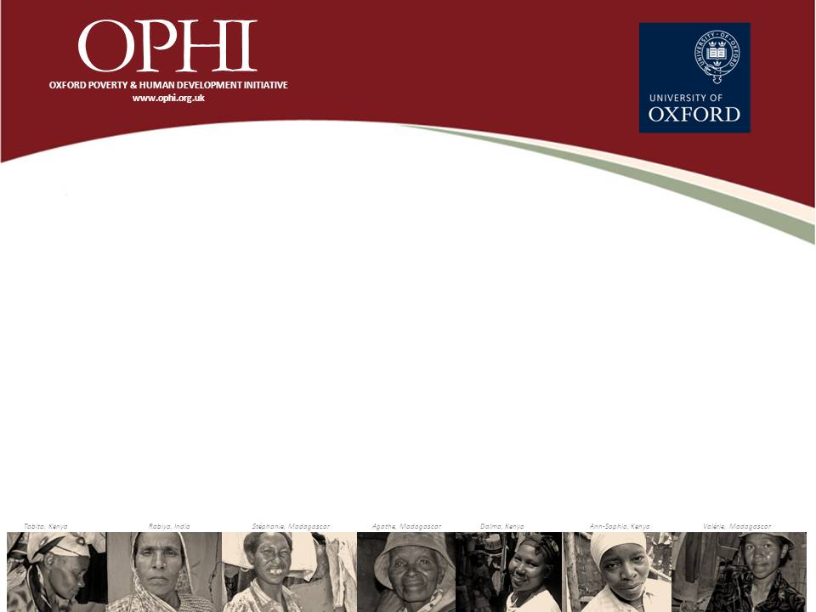
How poor are People with Disabilities around the Globe? A Multidimensional Perspective
Dra. Monica Pinilla Roncancio

Slide 2
Objective
To analyse the levels of multidimensional poverty of people with disabilities and their families in LMIC

Slide 3
Methods
11 Countries were selected
Country | Region | Year | Survey
Cambodia | East Asia | 2014 | DHS
Cameroon | Africa | 2011 | DHS
Chad | Africa | 2014-2015 | DHS
Colombia | Latin America | 2010 | DHS
Dominican Republic | Latin America | 2013 | DHS
Ecuador | Latin America | 2014 | ECV
Egypt | Middle East | 2014 | DHS
Gambia | Africa | 2013 | DHS
Mexico | Latin America | 2012 | ENSANUR
Uganda | Africa | 2011 | DHS
Yemen | Middle East | 2013 | DHS
Notes:
Those countries includes questions on disabilities in a source of data use to calculate the MPI

Slide 4
Methods
Definition of disability
Each country included different questions on disability
All questions were based on a functional approach
However, they used different wording
Limitations
Difficulties
Impairments
Only Uganda and Cambodia followed the WG suggestions
Colombia used a severity scale, but a time frame of 30 days and a list of 11 domains
Cameroon and Chad reported information on presence of at least one member with disability in the household

Slide 5
Methods
Definition of disability
A person was defined as a PwD if s/he reported to live with at least one limitation (in any of the domains included in the survey)
In the case of Uganda, Cambodia and Colombia
a person who reported to live with a severe difficulty or was no able to do an activity was classified as a PwD

Slide 6
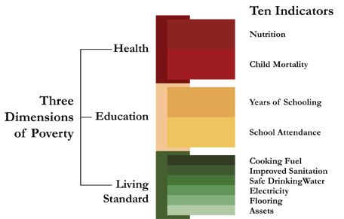
Global MPI and Destitution Index

Slide 7
Dimension | Indicator | Deprivation cutoffs Global MPI | Deprivation cutoffs Destitution Index
Education | Years of Schooling | No household member aged 10 years or older has completed five years of schooling | No household member aged 10 or older has completed at least one year of schooling
 | Child school attendance | Any school-aged child is not attending school up to the age they would complete class 8 | No children are attending school up to the age at which they should finish class 6
Health | Child mortality | Any child has died in the household in the past five years | Two or more children have died in the family
 | Nutrition | Any adult under 10 years of age or any child for whom there is nutritional information is malnourished | Severe undernourishment of any adult (BMI<17) or any children (-3 standard deviation from the median)
Living Standards | Electricity | The household has no electricity | The household has no electricity
 | Improved sanitation | The household’s sanitation facility is not improved (according to MDG guidelines) or it is improved but shared with other households | There is no sanitation facility (open defecation)
 | Safe drinking water | The household does not have access to safe drinking water or safe drinking water is at least a 30-minute walk from home round-trip | The household does not have access to safe drinking water or safe drinking water is more than a 45-minute walk from home round-trip
 | Flooring | The household has a dirt, sand or dung floor | The household has a dirt, sand or dung floor
 | Cooking fuel | The household cooks with dung, wood or charcoal | The household cooks with dung, wood or organic waste
 | Assets ownership | The household does not own more than one of the following items: radio, TV, telephone, bike, motorbike or refrigerator and does not own a car or truck | The household has no assets and no car

Slide 8
Results
Country | Percentage of people with disabilities | Percentage of households with disabled members
Cambodia | 4.95% | 17.74%
Cameroon | --** | 26.22%
Chad | --** | 19.7%
Colombia | 5.70% | 19.19%
Dominican Republic | 4.92% | 15.57%
Ecuador | 5.75% | 16.63%
Egypt* | 0.54% | 1.14%
Gambia | 2.74% | 16.06%
Mexico | 8.62% | 25.54%
Uganda | 4.36% | 15.70%
Yemen | 3.12% | 18.98%

Slide 9
 |  |  | Household with disabled members |  |  | Household without disabled members
 | % households with disabled members | Total Number of PHWD | MPI | Incidence H | Intensity A | MPI | Incidence H | Intensity A
Cambodia | 17.74% | 2,631,242 | 0.138 | 31.3% | 43.9% | 0.148 | 33.4% | 44.40%
 |  |  | 0.01 | 0.23 | 0.007 | 0.005 | 0.01 | 0.004
Cameroon | 26.22% | 5,566,261 | 0.367** | 62.2%** | 59.0% | 0.31 | 54.30% | 57.1%
 |  |  | 0.012 | 0.017 | 0.009 | 0.008 | 0.011 | 0.006
Chad | 19.70% | 2,504,947 | 0.565 | 89.1% | 63.4% | 0.549 | 86.6% | 63.40%
 |  |  | 0.009 | 0.011 | 0.004 | 0.005 | 0.054 | 0.006
Colombia | 19.19% | 9,001,155 | 0.026* | 6.5%** | 40.4% | 0.21 | 5.1% | 41.00%
 |  |  | 0.002 | 0.004 | 0.09 | 0.001 | 0.002 | 0.11
Dominican Republic | 15.57% | 1,581,139 | 0.022 | 5.20% | 42.3% | 0.021 | 5.50% | 38.8%
 |  |  | 0.009 | 0.22 | 0.09 | 0.002 | 0.06 | 0.097
Ecuador | 16.63% | 2,564,262 | 0.019** | 5.16%** | 38.73% | 0.012 | 3.14% | 38.50%
 |  |  | 0.002 | 0.004 | 0.005 | 0.001 | 0.002 | 0.003
Egypt | 1.14% | 976,534 | 0.091** | 21.0%** | 43.0%** | 0.018 | 4.80% | 37.90%
 |  |  | 0.03 | 0.057 | 0.007 | 0.001 | 0.003 | 0.001
Gambia | 16.06% | 290,221 | 0.342 | 62.9% | 55.1% | 0.32 | 59.8% | 54.30%
 |  |  | 0.024 | 0.38 | 0.002 | 0.012 | 0.19 | 0.001
Mexico | 25.54% | 31,176,924 | 0.011 | 2.83% | 38.1% | 0.011 | 2.78% | 39.2%
 |  |  | 0.0007 | 0.002 | 0.07 | 0.0006 | 0.0016 | 0.07
Uganda | 15.70% | 5,557,897 | 0.397 | 76.5%* | 52.0% | 0.361 | 68.7% | 52.6%
 |  |  | 0.02 | 0.03 | 1.1 | 0.01 | 0.017 | 0.005
Yemen | 18.98% | 4,722,753 | 0.252 | 49.3% | 51.1% | 0.232 | 45.1% | 51.40%
 |  |  | 0.009 | 0.016 | 0.006 | 0.007 | 0.11 | 0.006

Slide 10
Severity of MP
 | Severe Multidimensional Poverty
 | People living in households with members with disability | Confidence Interval 95% |  | People living in households without members with disability | Confidence Interval 95%
Cambodia | 9.1 | 7.1 | 11.6 | 10.9 | 9.7 | 12.2
Cameroon | 41.7 | 38.1 | 45.3 | 33.7 | 31.5 | 36.1
Chad | 70.3 | 67.0 | 73.6 | 66.3 | 64.6 | 68
Colombia | 1.2 | 0.95 | 1.6 | 1.1 | 0.9 | 1.3
Dominican Republic | 0.4 | 0.02 | 0.7 | 0.6 | 0.3 | 0.8
Ecuador | 0.7 | 0.45 | 1.0 | 0.36 | 0.3 | 0.44
Egypt | 8.7* | 2.5 | 25.9 | 0.5 | 0.4 | 0.7
Gambia | 42.2 | 34.2 | 50.6 | 35.9 | 32.3 | 39.6
Mexico | 0.3 | 0.2 | 0.5 | 0.4 | 0.32 | 0.5
Uganda | 43.4 | 36.6 | 50.5 | 37.2 | 34.1 | 40.43
Yemen | 24.8 | 22.3 | 27.5 | 22.8 | 20.9 | 24.9
Notes:
Except Cambodia and Mexico PwD and their families have higher levels of severe multidimensional poverty.

Slide 11
Destitution
Incidence Destitution
Country | All households | Number of people living in households with disabled members destitute | People living in households with disabled members | Confidence Interval 95% |  | People living in households without disabled members | Confidence Interval 95%
Cambodia | 9.8 | 729 | 9.3 | 6.7 | 11.9 | 9.9 | 8.7 | 11.1
Cameroon | 29.3 | 2874 | 34.1* | 30.6 | 37.6 | 27.6 | 25.5 | 29.8
Chad | 62.3 | 8001 | 65.7 | 62 | 69.4 | 61.5 | 59.4 | 63.5
Colombia | 1.1 | 368 | 0.78 | 0.54 | 0.1 | 0.76 | 0.63 | 0.9
Dominican Republic | 0.6 | 6 | 0.1 | na | na | 0.6 | 0.3 | 1
Ecuador | 0.7 | 424 | 1.15* | 0.8 | 1.4 | 0.6 | 0.5 | 0.8
Egypt | 0.9 | 26 | 2.4 | 0.1 | 4.7 | 0.9 | 0.6 | 1.1
Gambia | 24.5 | 1277 | 27.8 | 19.7 | 35.8 | 23.9 | 20.5 | 27.2
Mexico | 0.6 | 420 | 0.6 | 0.4 | 0.7 | 0.6 | 0.4 | 0.7
Uganda | 29.8 | 594 | 32.2 | 25.4 | 39.1 | 29.3 | 26.3 | 32.2
Yemen | 18.7 | 5,006 | 21.1 | 19.4 | 24.3 | 18.0 | 16.2 | 19.8

Slide 12
Results
Uganda
Disaggregating the data in three groups
People without disabilities
People with moderate disabilities
People with severe/total disabilities

Slide 13
Results
Uganda
 | H | Destitution
No disability | 68,3% | 29,3%
Moderate disability | 73,6% | 32,4%
Severe/total disability | 76,6% | 33,3%
Total | 69,5% | 30,0%

Slide 14
Results
Cambodia
 | H | Destitution
No disability | 32.03% | 9.4%
Moderate disability | 32.67% | 9.0%
Severe/total disability | 31.18% | 9.8%
Total | 32.03% | 9.4%

Slide 15
Results
Uganda
 | %
No disability | 80.06
Moderate disability | 15.58
Severe/total disability | 4.36

Slide 16
Conclusions
In most countries people with disabilities and their families face:
Higher levels of multidimensional poverty
Higher levels of severe multidimensional poverty
Higher levels of destitution
However, in some cases differences are not significant

Slide 17
Conclusions
Importance to analyse the levels of multidimensional poverty using global MPI and national MPIs
Using the household as unit of identification: It is not possible to analyse intra-household inequalities and differences in the levels of deprivation of members with and without disabilities

Slide 18

Any question?

